Slide 1
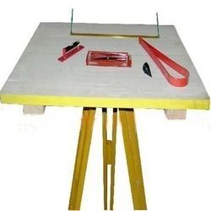
Plane Table Surveying
Prof Gaikwad K.S.

